Slide 1
Stock price prediction using sentiment analysis
Group 10
Luuk, Velin, Tim & Ivo

Slide 2

Introduction
Analyzing how tweets about Apple Inc. affect Apple’s stock price
Use of Random Forest Classification algorithm
Use of two datasets

Slide 3
Data collection
Kaggle and Yahoo Finance
Dataset 1 - Apple sentiment polarity scores
Dataset 2 - Apple stock price for the period 01/01/2016 - 02/09/2019

Slide 4
Data preparation
Match the time frame of the two datasets
Remove any observations from Dataset 1 that are from Saturday, Sunday
Combine the two datasets into one file
Process the data in Python, using Pandas library

Slide 5
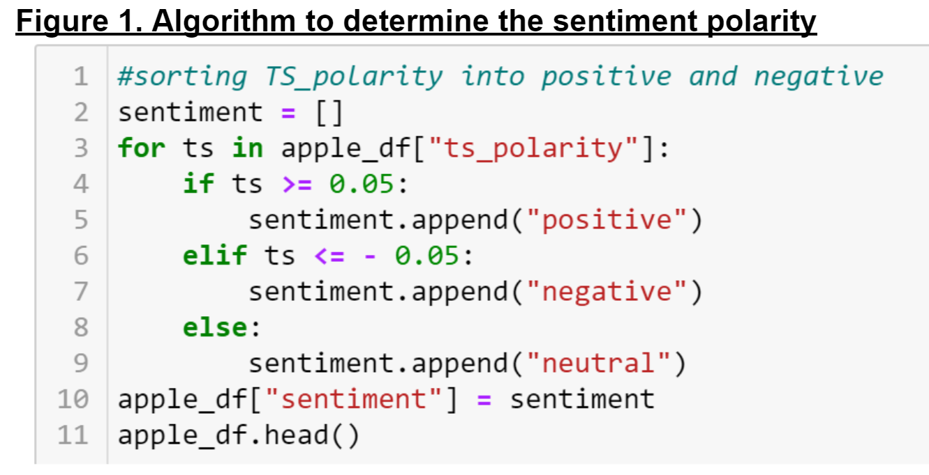
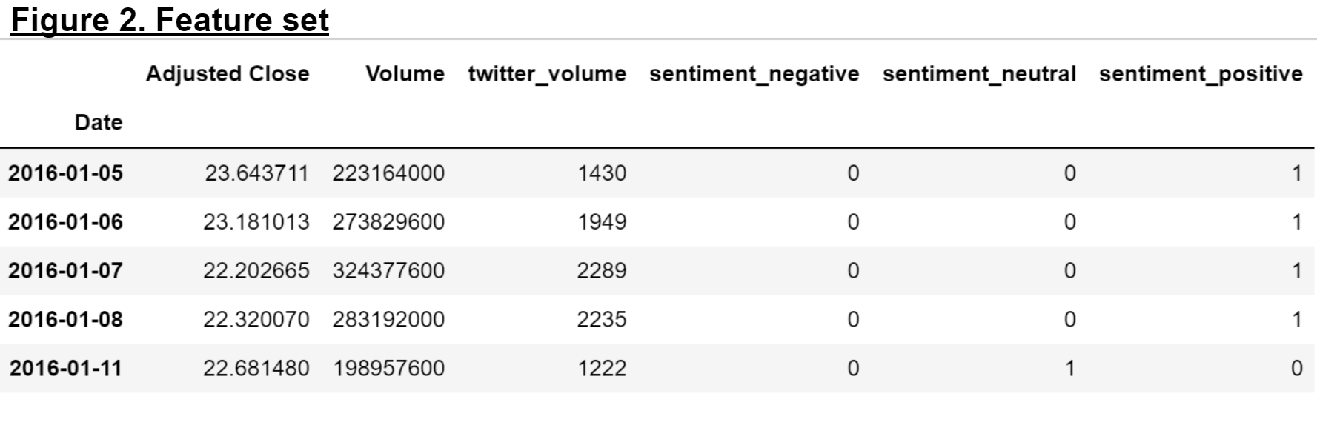
Modelling and analytics

Slide 6
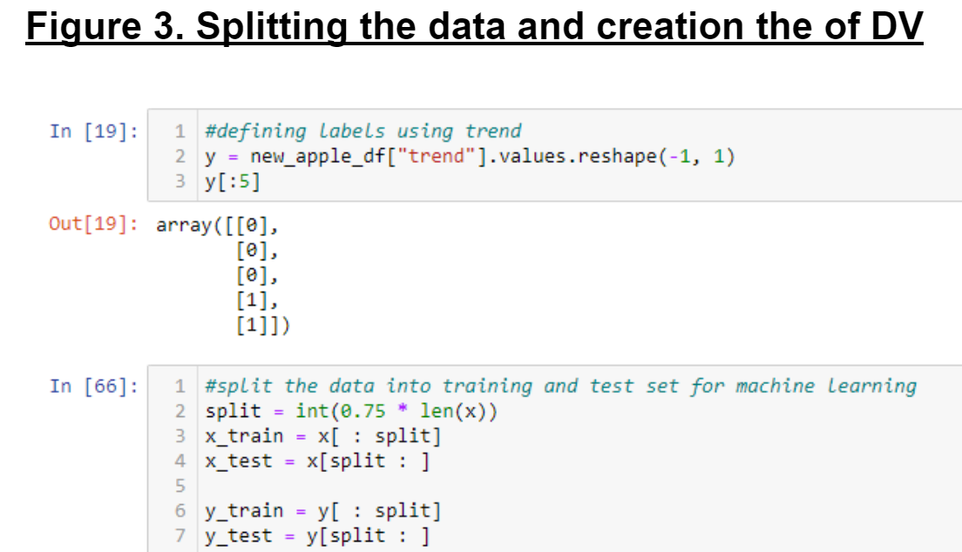
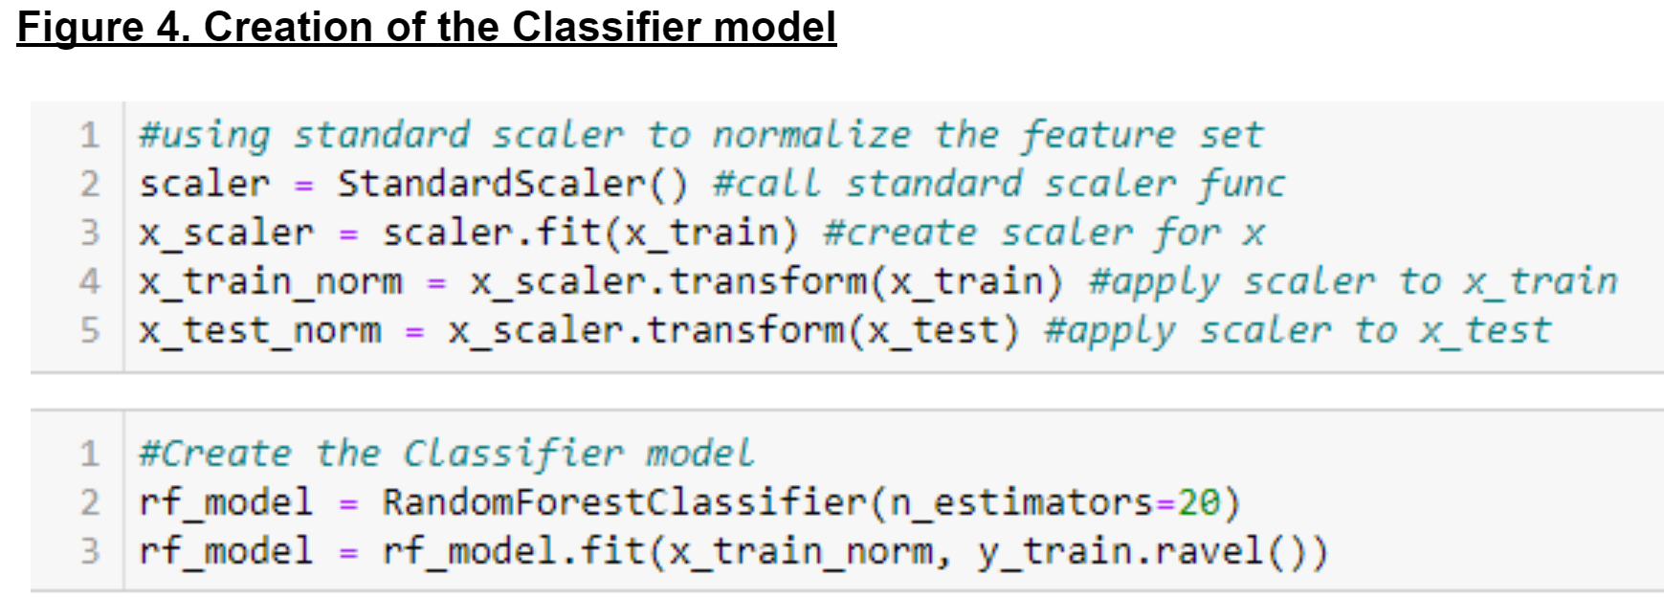
Modelling and analytics

Slide 7
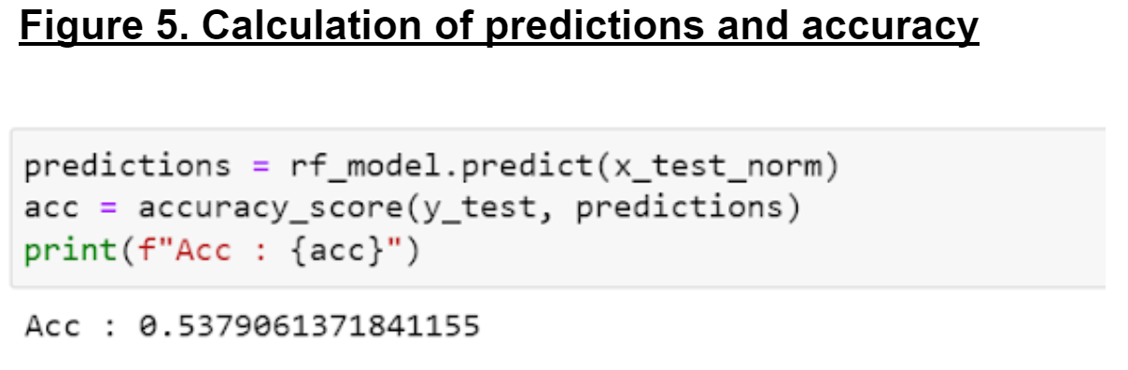
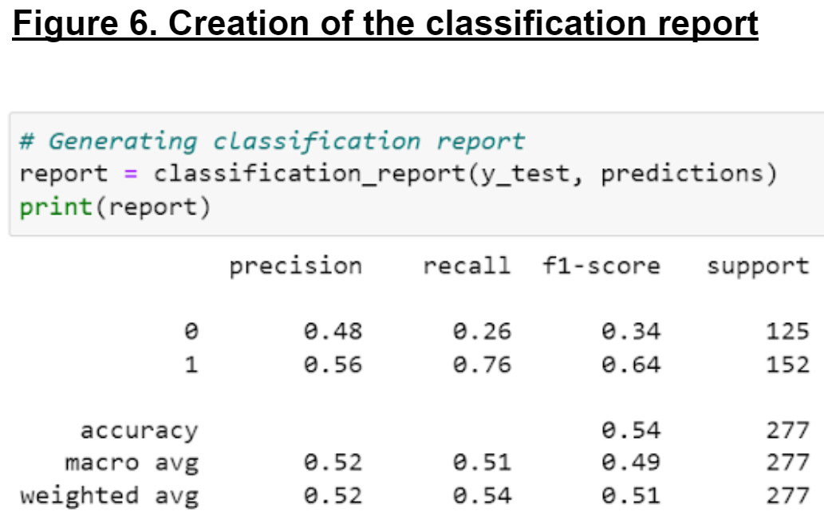
Validation

